Slide 1

High-end laptop
Asiadouskaya Hanna

Slide 2
What does high-end laptop mean?
A laptop with top-shelf hardware is a high-end laptop. The main reason why you'll pay more for a computer because it includes more expensive parts. Workstations built for pros contain professional-grade features such as Intel processors, NVIDIA graphics cards, top-notch audio, photo and video editing resolutions and low-latency memory.

Slide 3
Barebones Laptop
A barebones laptop is a half-assembled personal computer with a laptop shell, power supply, motherboard, camera, keyboard and cooling system.
Users can decide which component (CPU, memory, storage devices) to buy and install, according to their own needs and budget.
They are usually produced by Original Design Manufacture (ODM) like Quanta, Compal, Wistron, Clevo or MSI. These ODM companies produce PCs for some brands (OEM) like Dell, HP, Lenovo, Acer, Mac, etc. Then, these products will be sold to users as OEM products.

Slide 4
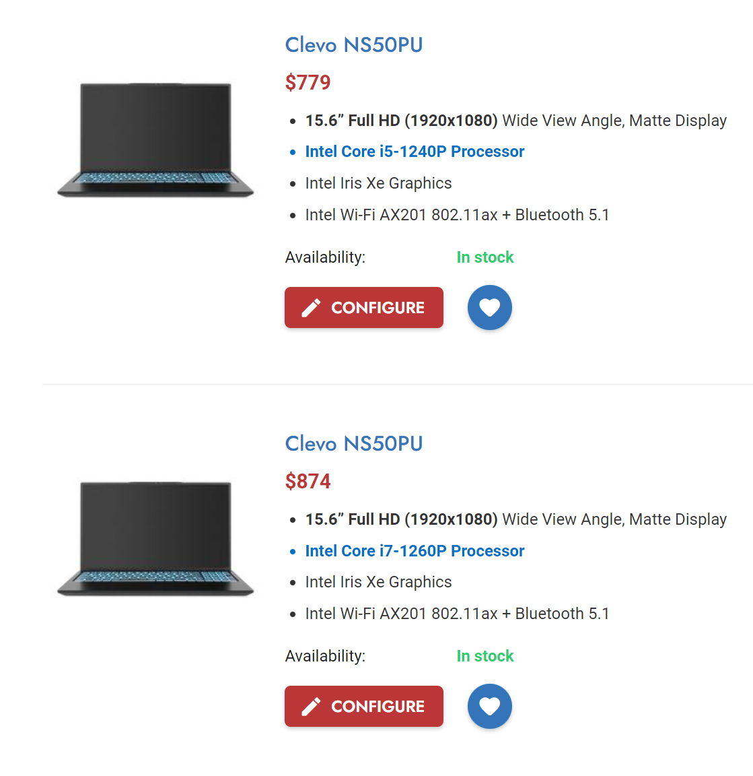
More often barebone laptops goes with CPU or/and graphic card. So, to choose a proper barebones laptop, you should pay attention to the following aspects: whether the CPU and the graphics card are replaceable, the maximum number and capacity of memory it supports, the number of hard disk interfaces, the types of hard disk it supports, the screen interface, etc.
If the barebones laptop has enough interfaces or its hardware is replaceable, you have the opportunity to increase its performance again, just by spending money on the replacement of partial hardware

Slide 5
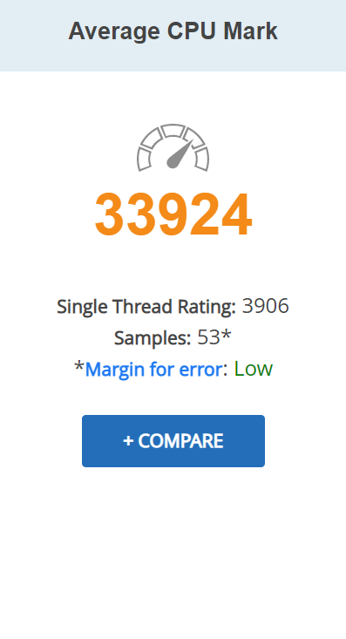
Processor
The Intel Core i7-12800HX is a high-end mobile CPU for laptops based on the Alder Lake architecture. It was announced in mid 2022 and offers 8 performance cores (P-cores, Golden Cove architecture) and 8 efficient cores (E-cores, Gracemont architecture).
This is a newly released CPU that contains 16 Cores and 24 Threads. The Intel Core i7-12800HX also has reasonable threaded performance that will serve well in games and in graphic projects. Paired with a good videocard this would be a suitable CPU for gaming and editing.

Slide 6
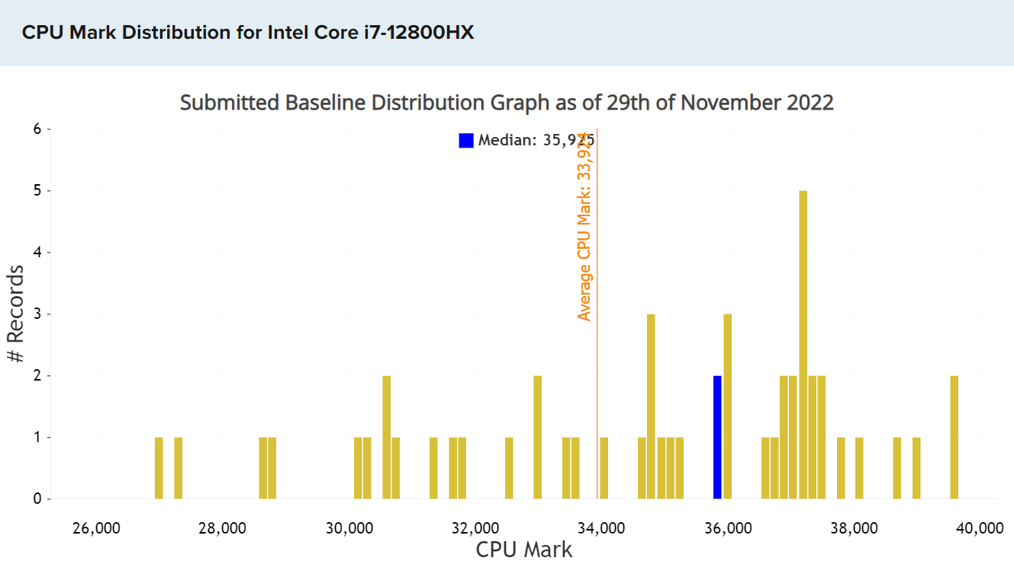

Slide 7
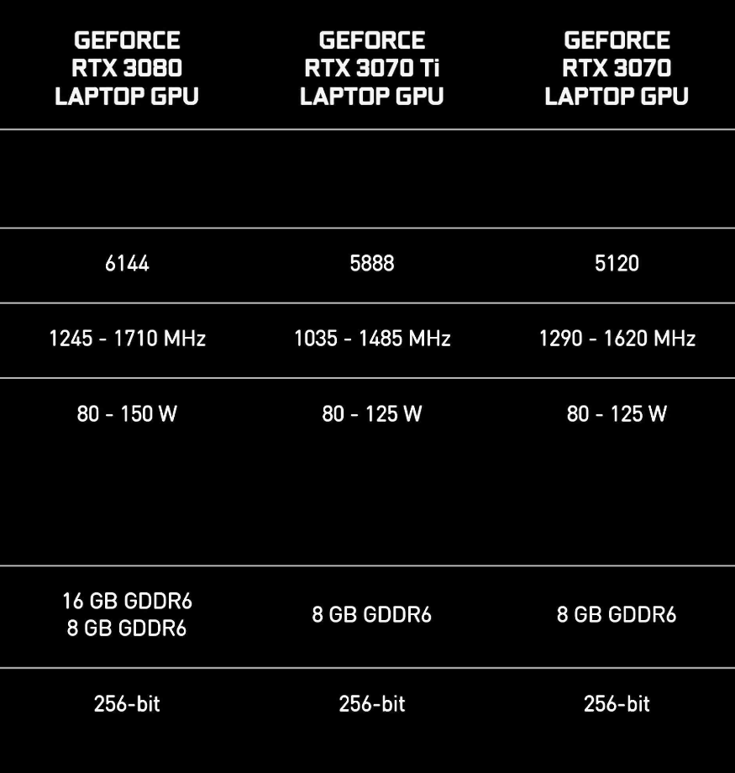
Graphics
The Nvidia GeForce RTX 3070 Ti Laptop GPU (mobile, GN20-E6, Max-P, Max-Q) is a mobile graphics card for notebooks and the refresh of the RTX 3070.
The GeForce RTX 3070 is excellent choice for one-step down play from a RTX 3080 that's still capable at 4K, while the more recently released seat filler between those two, the GeForce RTX 3070 Ti, is a bit expensive but hits 60fps at 4K more reliably than its predecessor.

Slide 8
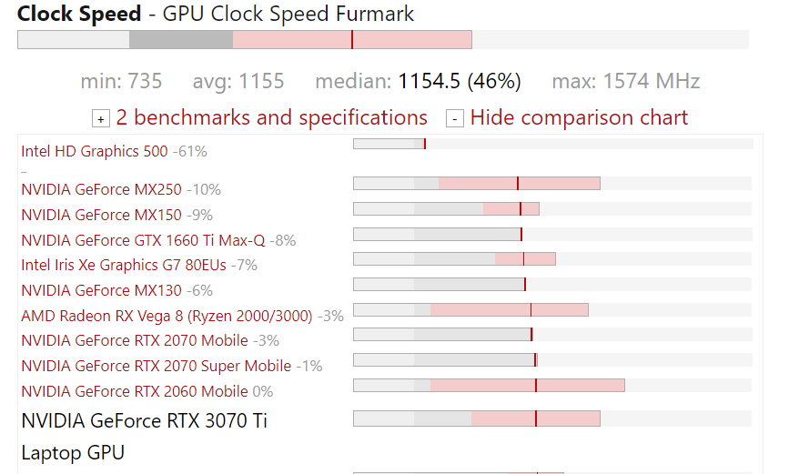
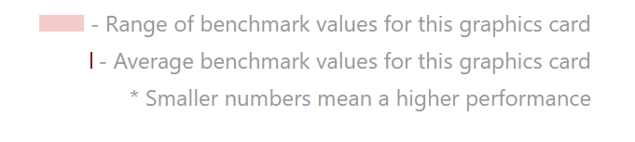
Compared to the old card, the newer one offers 15% more shaders but less clock speed. It will still feature the 256 Bit memory bus and 8 GB GDDR6. The RTX 3070ti is available in different power variants ranging from 80 Watt TGP with a Boost clock of 1035 MHz up to 125 Watt models with a Boost clock of 1485 MHz.
The RTX 3070 Ti does best as a 1440p gaming solution, which remains the sweet spot in terms of image quality and performance requirements.

Slide 9
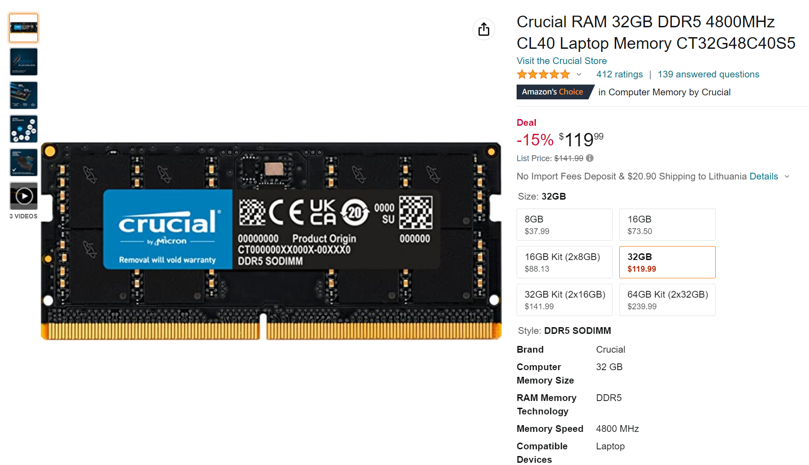
Memory
As you’d expect, these can be purchased as one UDIMM or in dual-channel/module kits.
Like other Crucial memory modules, the DDR5 4800 RAM is sold bare. However, it’s an excellent option for system builders who are planning to upgrade their OEM machines.

Slide 10
The New DDR5 Standard and Its Benefits
Alder Lake brings a new DDR memory standard. This is made to handle all the memory demands of modern systems and processor architectures. It guarantees increased memory speed though at the expense of higher latencies.
DDR comes with tons of notable benefits including increased load times and file transfers. Other than these, there’s also optimised innovation for stable and balanced performance, more responsive multitasking, and enhanced power efficiency.

Slide 11
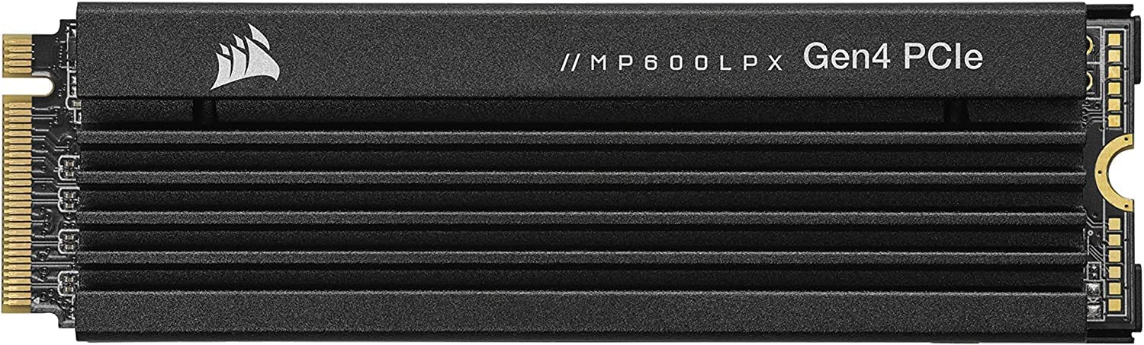
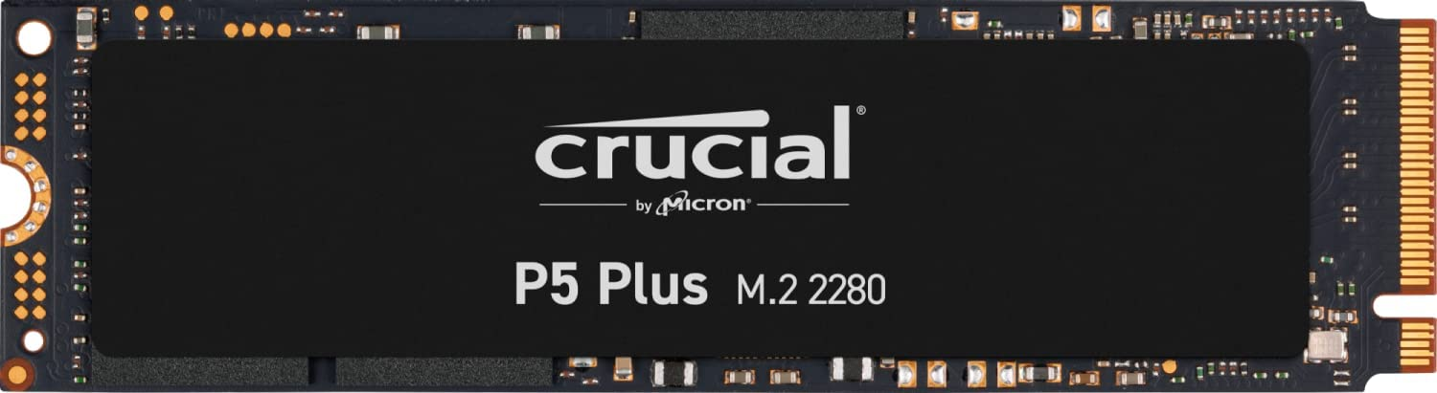
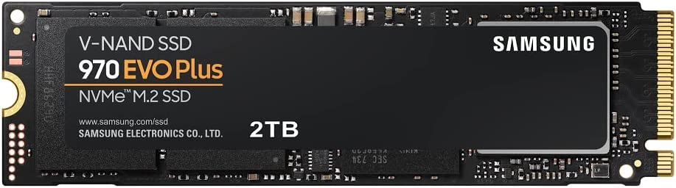
Storage
M.2 SSD look like sticks of gum studded with NAND modules and a controller chip.
M.2 drive length isn't always an indicator of drive capacity(it can vary from 80mm to 42 mm), but there are limits to NAND-chip density and how many memory modules engineers can stuff into.
Most of the M.2 drives have topped out at 2TB, though you can find a few 4TB and 8TB models at lofty prices.

Slide 12
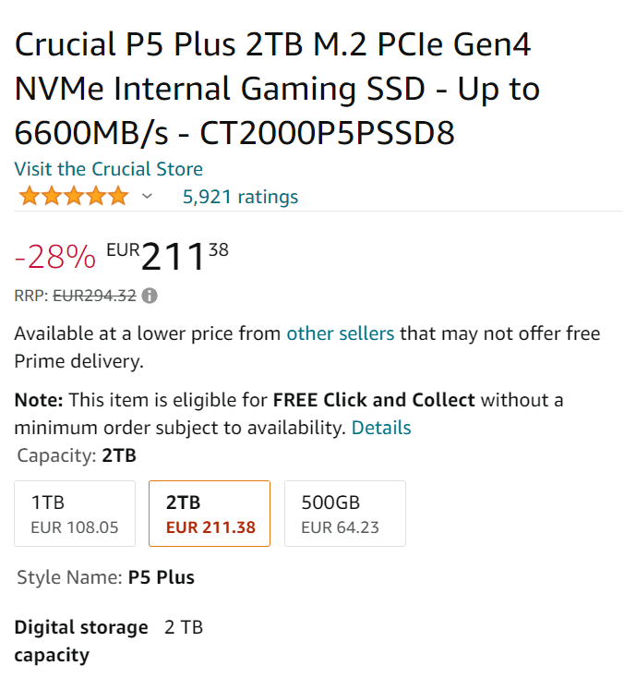
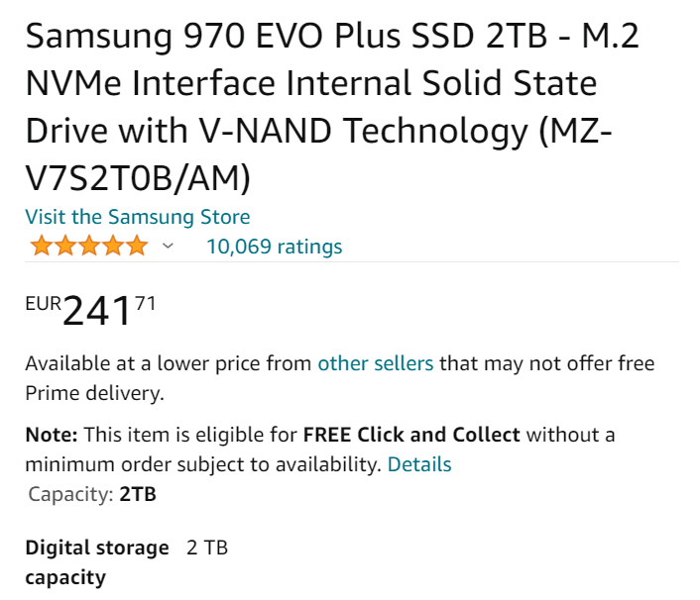
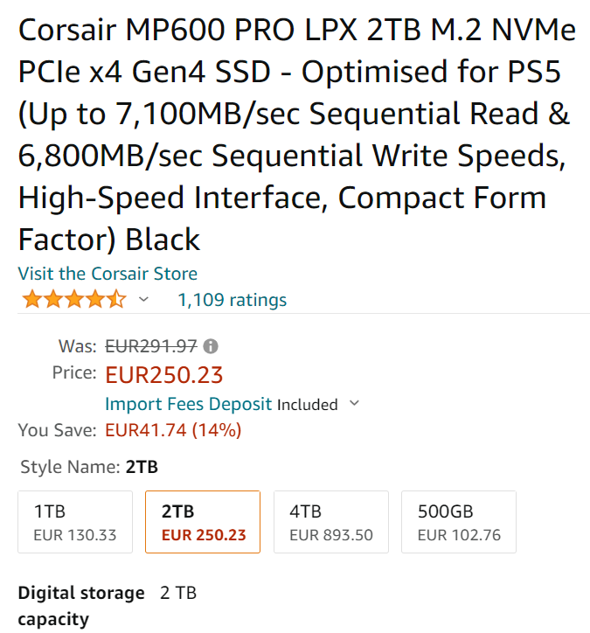
Mine top 3 of M.2 SSD. All of them provide solid benchmark performance with top-tier scores. Also offering excellent performance for creative tasks, if not necessarily for gaming.

